Slide 1
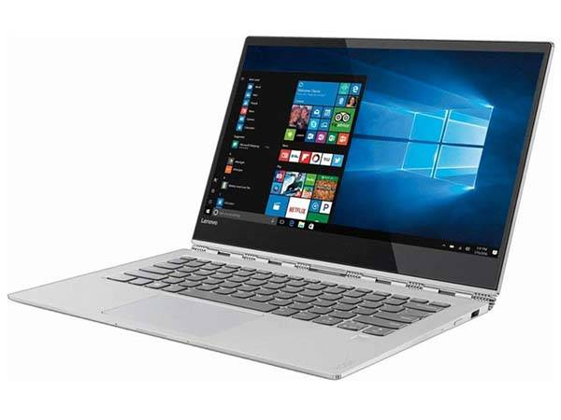
LAPTOP SHOPPING WEBSITE
Presenter’s Name
Ajithkumar
Yuvasri Sankar
Lakshmi PM
Ragapriya
This Photo by Unknown Author is licensed under CC BY-SA-NC

Slide 2
Agenda
Introduction
Languages &Tools
Models
Schema Diagram
Future Implementation
Conclusion

Slide 3
Introduction
Laptop shopping website is a form of electronic commerce which allows to directly buy laptop from a seller over the internet using a browser.
It is a B2C process.ie business to consumer ecommerce.
Customers can shop laptop online using a range of different computers and devices , including desktop computers , laptops and smartphones.
Online customers must have access to the Internet and a valid method of payment in order to complete a transaction.
Online stores are usually available 24 hours a day.

Slide 4
Languages & Tools
Language: java
Tools: spring boot ,Jpa hibernate,spring boot framework
postman and mysql.

Slide 5
Modules
Admin Model
Customer Model
Category Model
Product Model
Wishlist Model
Order Model
Payment Model
Feedback Model
Service Model

Slide 6
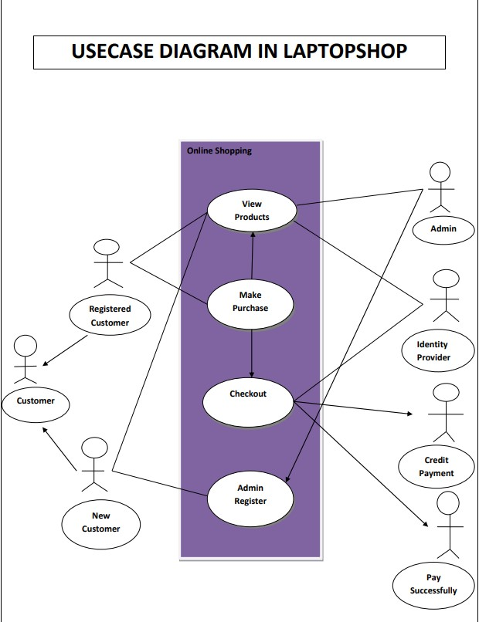
Usecase Diagram

Slide 7
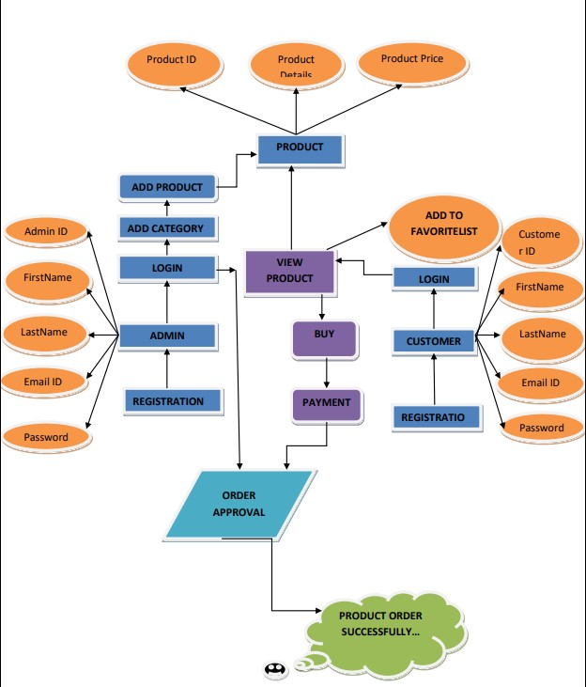
ER Diagram

Slide 8
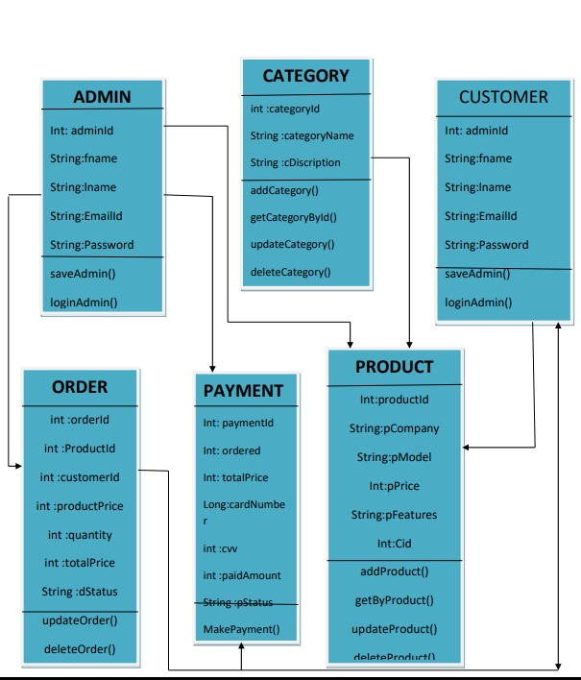
Class Diagram

Slide 9
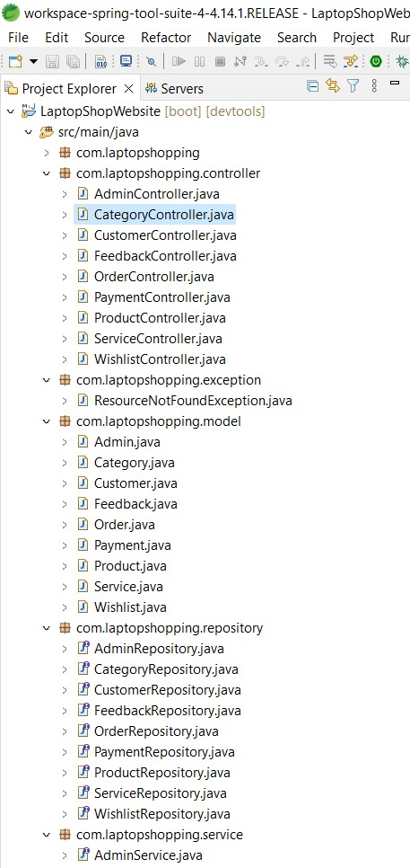

Slide 10
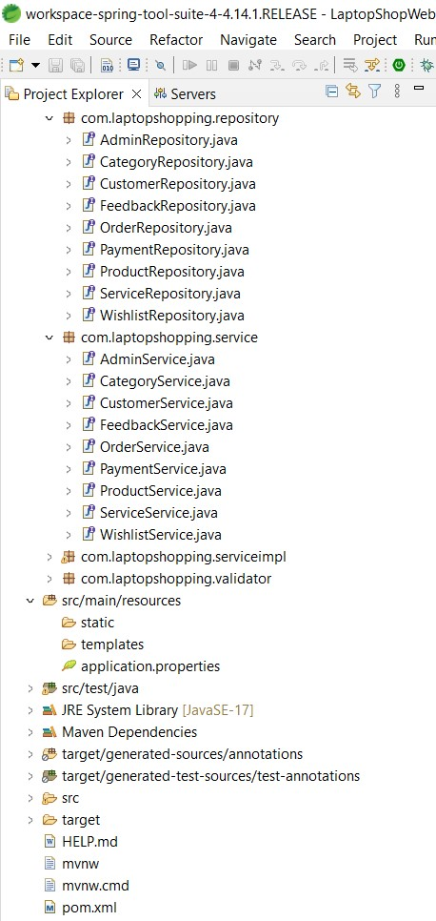

Slide 11
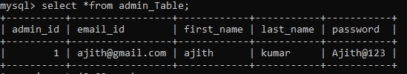
Admin Model
Admin entity has following attributes:
1.admnId
2.adminEmailId
3.adminFirstName
4.adminLastName
5.adminPassword
The functions done by admin are:
1.Register
2.Login
3.AddCategory
4.AddProduct

Slide 12
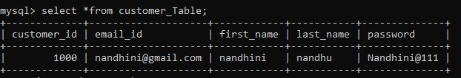
Customer Model
Customer entity has following attributes:
1.customerId
2.customerEmailId
3.customerFirstName
4.customerLastName
5.customerPassword
The functions done by admin are:
1.Register
2.Login
3.Order
4.Payment
5.Service
6.Feedback

Slide 13
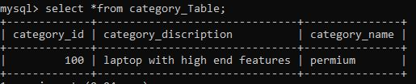
Category Model
Category entity has following attributes:
1.categoryId
2.categoryName
3.categoryDescription

Slide 14
Product Model
Product entity has following attributes:
1.productId
2.productCompany
3.productFeatures
4.productModel
5.productPrice
6.categoryId

Slide 15

Wishlist Model
Wishlist entity has following attributes:
1.wishlistId
2.wishlistName
3.productId

Slide 16
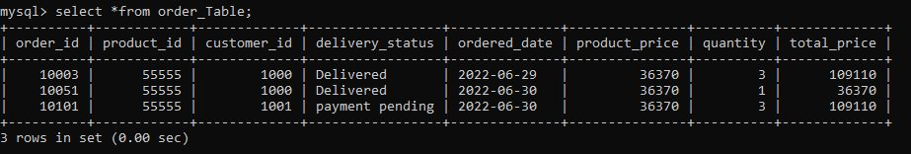
Order Model
Order entity has following attributes:
1.orderId
2.productId
3.customerId
4.deliveryStatus
5.orderDate
6.productPrice
7.quantity
8.totalPrice

Slide 17
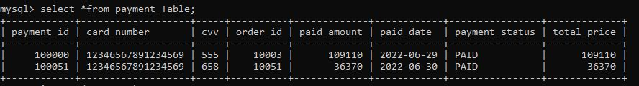
Payment Model
Payment entity has following attributes:
1.paymentId
2.cardNumber
3.CVV
4.orderId
5.paidAmount
6.paidDate
7.paymentStatus
8.totalPrice

Slide 18
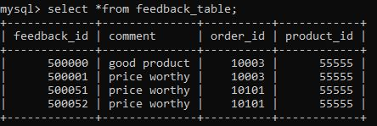
Feedback Mode
Feedback entity has following attributes:
1.feedbackId
2.comment
3.orderId
4.productId

Slide 19
Service Model
Service entity has following attributes:
1.serviceId
2.customerId
3.orderId
4.productId
5.serviceDate
6.serviceDetails
7.serviceStatus

Slide 20
Future Implementation
Online sales will continue to rise.
Every webpage designed to sell a product or market a service should understand Future of online laptop shopping.

Slide 21
Conclusion
It is an user friendly application and promotes user to purchase faster.
With new technology comes better way of doing things.
Being able to buy anytime anywhere.

Slide 22


